Slide 1
IBM University Engagement Project Submission
“Exploring the Power of Agentic AI with IBM Granite and LangFlow”

Slide 2

Project Tile – EduEase AI Personalized Course Content Simplification Agent
Domain of Project – Education
Student Name | Recent Passport Photo | Email ID | Mobile number [WhatsApp]
Kunal Rajesh Agrawal
agrawalkunal689@gmail.com
7567492365

Slide 3
Problem Statement :
Problem Statement – Course Content Simplification Agent
The Challenge
Educational materials often vary in complexity and are not always accessible to learners with different levels of prior knowledge. Students may struggle to understand jargon-heavy faculty notes, textbooks, and study material, especially when explanations are too advanced or not tailored to their learning level. Without personalized academic support, many learners find it difficult to grasp key concepts, revise effectively, and prepare confidently for exams.
The Objective
Build an AI-powered Course Content Simplification Agent that delivers personalized learning support for students by transforming difficult academic content into learner-friendly explanations and study resources.
The solution should:
Learner-Level Simplification – Adapt academic content for Beginner, Intermediate, and Expert learners.
Summary Generation – Produce concise summaries for quick revision and concept understanding.
Assessment Support – Generate MCQs and exam questions from uploaded study material.
Keyword Explanation – Identify and explain important academic terms in simple language.
Question Answering – Allow students to ask doubts from the uploaded content and receive contextual answers.
PDF/Text-Based Learning Support – Accept faculty notes, textbook content, or pasted text as input for analysis and transformation.
Smart Academic Assistant – Act as a digital study companion for understanding, revision, and exam preparation.

Slide 4
Proposed Solution :
The proposed solution is an AI-powered Course Content Simplification Agent built using IBM watsonx.ai, IBM Granite models, Python, and Streamlit to make academic content easier to understand for learners with different proficiency levels. The system addresses the challenge of complex, jargon-heavy educational material by transforming it into learner-friendly explanations and study resources.
At its core, EduEase AI allows users to upload PDF notes or paste academic text, which is then processed by the system. Using IBM Granite models through watsonx.ai, the content is analyzed and converted into multiple educational outputs such as simplified explanations, summaries, MCQs, exam questions, keyword explanations, and answers to learner questions.
The solution supports learner-level personalization, where the same academic content can be adapted for Beginner, Intermediate, or Expert learners. This ensures that students with different levels of prior knowledge can understand the same material in a way that matches their learning needs.
The system consists of multiple AI-driven functions:
Content Simplification Module – rewrites difficult academic text into learner-friendly language
Summary Module – generates concise bullet-point summaries for revision
Assessment Module – creates MCQs and important exam questions from the content
Keyword Explanation Module – identifies and explains important academic terms
Question Answering Module – answers student questions using the uploaded study material
The solution includes a user-friendly Streamlit interface where students can upload notes, choose learner level, and interact with the generated learning support.
Overall, EduEase AI acts as a smart academic assistant that improves concept clarity, supports revision, and promotes personalized learning through IBM-powered AI.

Slide 5
Technology Used :
Streamlit – Used to build the interactive web interface for uploading PDFs, pasting academic content, selecting learner level, and displaying AI-generated outputs.
IBM Granite Model – Granite-3-3-8B-Instruct is used for academic content simplification, summarization, MCQ generation, exam question generation, keyword explanation, and question answering.
IBM watsonx.ai – Used for secure access to IBM Granite models, prompt-based inference, and AI-powered educational output generation.
IBM Cloud – Provides the cloud-based AI environment and infrastructure for integrating and scaling the EduEase AI solution.
PyMuPDF (fitz) – Used to extract text from uploaded PDF notes and academic documents.
Python + Requests + Dotenv – Used for backend logic, API integration with watsonx.ai, and secure environment variable management.

Slide 6
Component Used In Agent:
1) Chat Input – Used to accept academic text, learner questions, or study content from the user.
2) Prompt / Agent Flow – Processes the uploaded content and selected learner level to perform tasks like simplification, summarization, MCQ generation, and question answering.
3) IBM watsonx.ai Agent – Connects with IBM Granite model to generate educational outputs from academic content.
4) IBM Granite Model Used – Granite-3-3-8B-Instruct for content simplification, summaries, MCQs, exam questions, and doubt solving.
5) Chat Output – Displays AI-generated outputs such as simplified explanations, summaries, MCQs, exam questions, keyword explanations, and answers.
6) File / PDF Input Component – Used to upload and extract academic content from PDF notes for further processing by the AI agent.

Slide 7
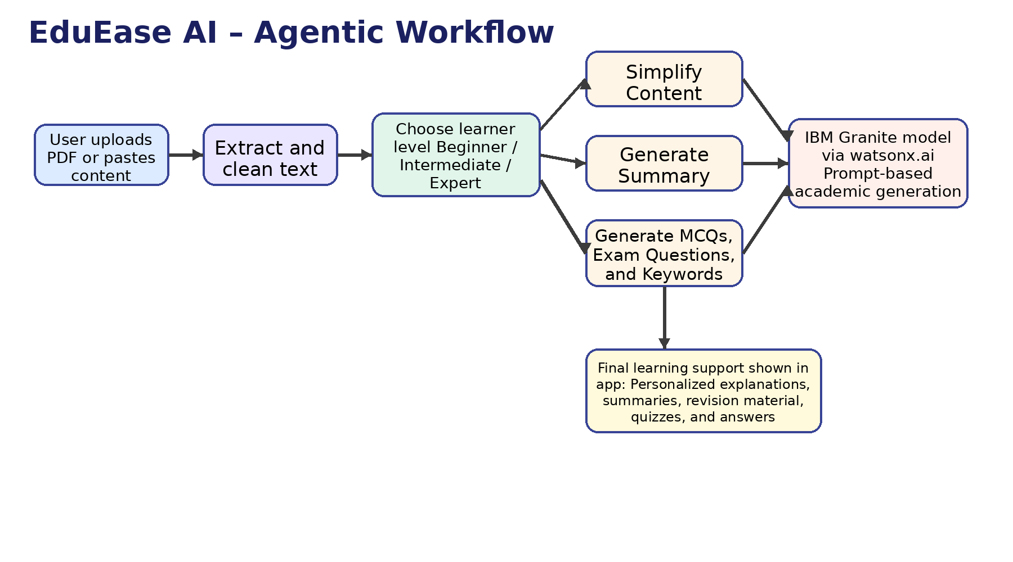
EduEase AI - Agentic workflow :

Slide 8
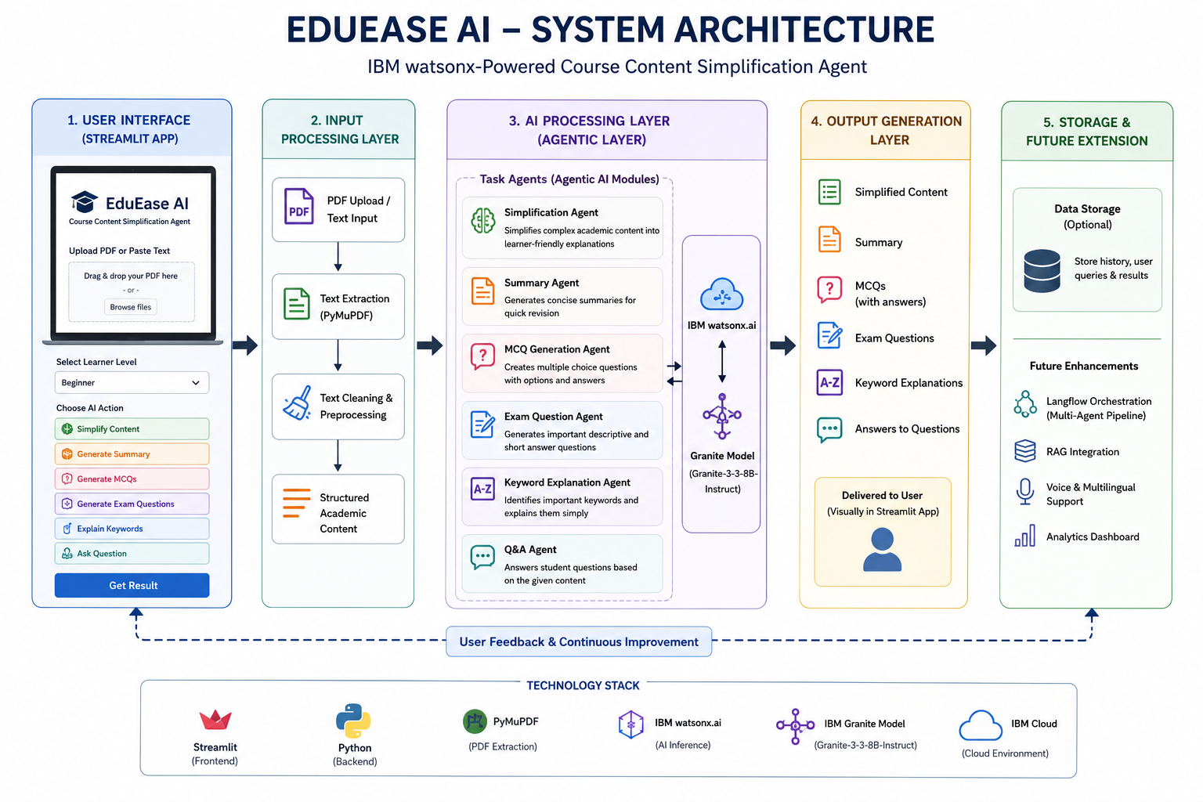
System Architecture :

Slide 9

Role of Agentic AI in the solution :
Role of Agentic AI in the Solution
Agentic AI enables EduEase AI to act as an intelligent academic assistant instead of a basic chatbot. Using IBM watsonx.ai and Granite models, it performs multiple tasks such as content simplification, summarization, MCQ generation, exam question generation, keyword explanation, and question answering.
It also adds personalization by adapting explanations according to the learner’s level — Beginner, Intermediate, or Expert. This makes the system more interactive, task-oriented, and useful for understanding and revising academic content.

Slide 10
Novelty and Uniqueness :
Multi-Agent Academic Support – EduEase AI uses multiple AI functions such as content simplification, summarization, MCQ generation, exam question generation, keyword explanation, and doubt solving instead of acting like a basic single chatbot.
Learner-Level Personalization – The system adapts academic content for Beginner, Intermediate, and Expert learners, making difficult study material easier to understand.
IBM Granite-Powered Intelligence – Built using IBM watsonx.ai and Granite models to generate reliable educational outputs from uploaded notes and text.
Interactive Learning Experience – Students can not only simplify content but also ask questions, generate quizzes, and prepare exam questions from the same study material.
Transforms Content into Learning Resources – Converts raw academic notes into student-friendly explanations, summaries, MCQs, keywords, and revision material.
Scalable and Deployment-Ready – Designed on IBM Cloud technologies, making it suitable for future expansion in personalized education platforms and smart learning systems.
EduEase AI is not just a content simplifier, but a smart academic learning assistant that personalizes, explains, and transforms study material into effective learning support.

Slide 11
Git Hub Link :
· Please create public github repository (Enable Add README button while creating repository) with format –
Please test and Paste the working Github URL –
Make sure you have Uploaded following three files into your github repository 1) app.json file , 2) yourproblemstatement.pdf file 3) your projectpresntation.pptx file 4)any other files
·
·
·

Slide 12
Future Scope :
1. Multilingual and Voice-Based Learning Support –
The system can be enhanced with voice interaction and multilingual support so that students can learn and ask questions in their preferred language. This will improve accessibility and make the platform more inclusive for diverse learners
2. Advanced Personalization and Smart Learning Features –
In future, EduEase AI can be upgraded with student progress tracking, adaptive learning paths, and topic-wise recommendations based on learner performance and understanding level. This will make the system more intelligent, personalized, and useful for long-term academic support.

Slide 13
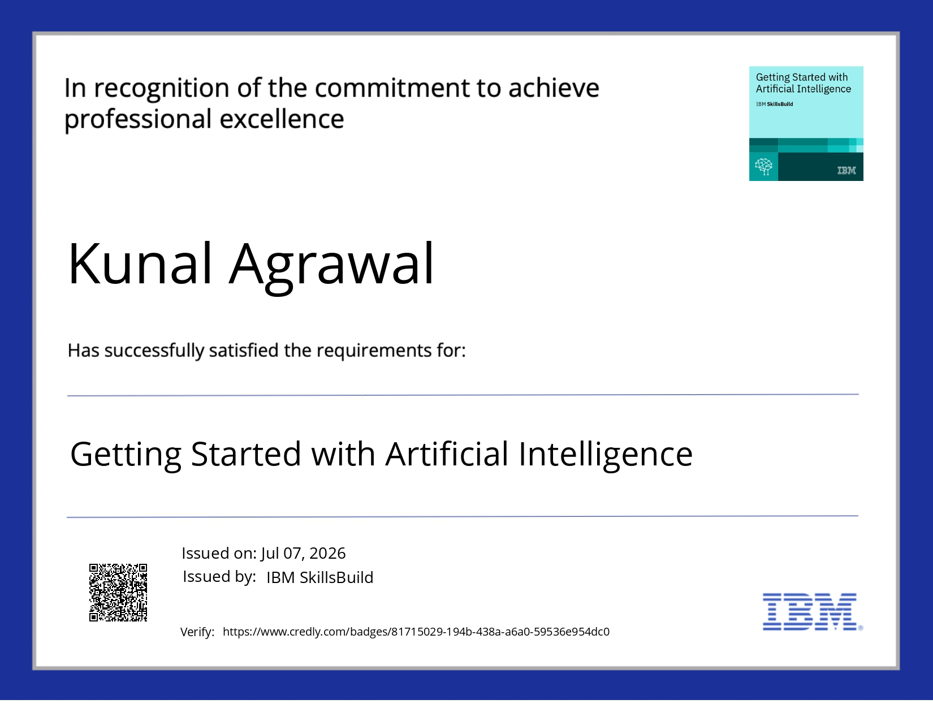
Certificates Earned :

Slide 14
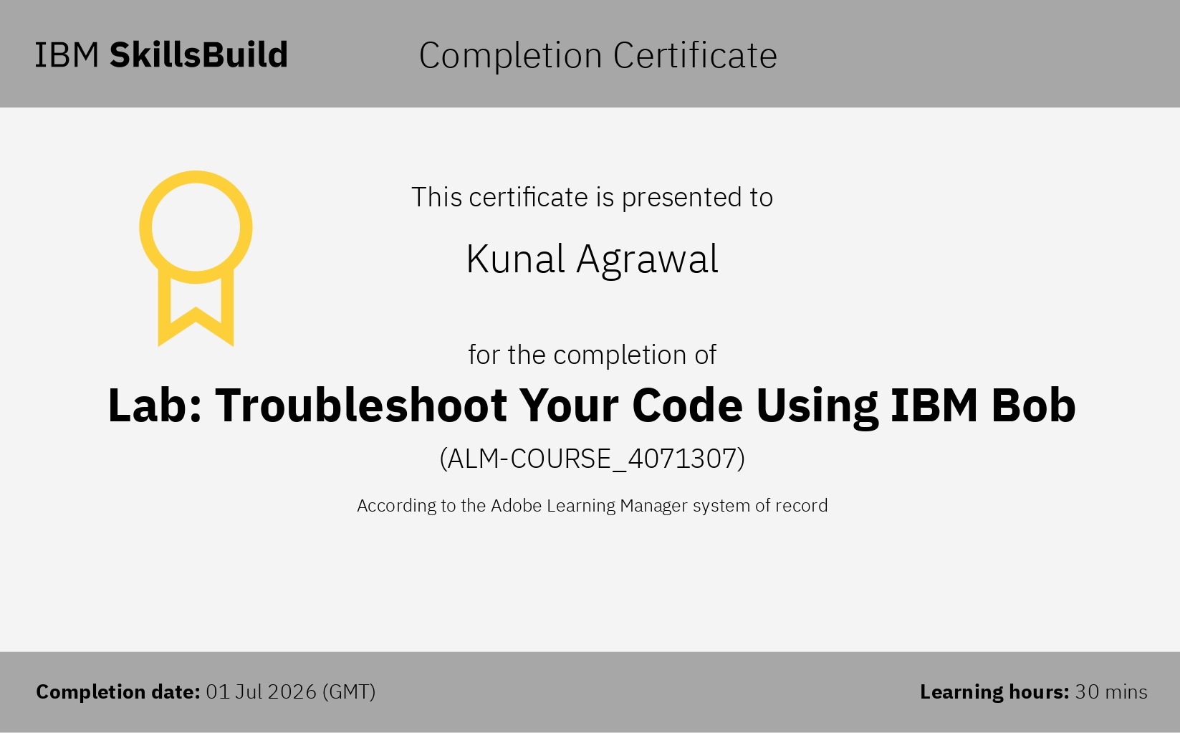
Certificates Earned :​

Slide 15


